Slide 1



Pierdomenico Fiadino
The Telecommunications Research Center Vienna (ftw.)
Vivisecting WhatsApp in Cellular Networks
Servers, Flows, and Quality of Experience
fiadino@ftw.at
http://userver.ftw.at/~fiadino

Slide 2

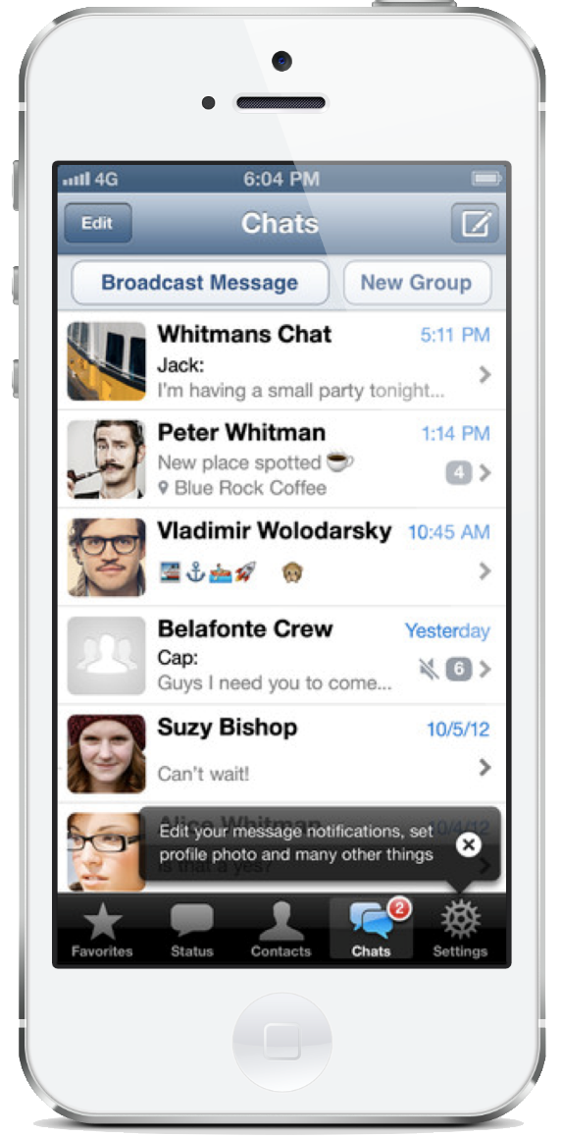

WhatsApp overview
Hard facts:
64 billion messages per day
700 million photos
100 million videos
500 million of daily active users
Company with the quickest growing user base in history
Acquired by Facebook for 19 billion $
Each user is worth 40$
Operators need to investigate it because:
It is taking over (or already has...) the SMS/MMS market
They need to learn how to track its usage
They need to understand its impact on their networks

Slide 3
Outline
Characterization of WhatsApp through hybrid measurements
Traffic captures in lab with standard tools
Large-scale passive traces (mobile national network)
Large-scale active measures (RIPE Atlas)
Quality of Experience remarks
Build a QoE model with user tests
Apply model on passive traces
WhatsApp global outage overview
Characterization
Social media impact

Slide 4
Outline
Characterization of WhatsApp through hybrid measurements
Traffic captures in lab with standard tools
Large-scale passive traces (mobile national network)
Large-scale active measures (RIPE Atlas)
Quality of Experience remarks
Build a QoE model with user tests
Apply model on passive traces
WhatsApp global outage overview
Characterization
Social media impact

Slide 5



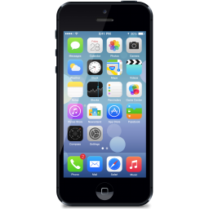

Reverse engineering Whatsapp naming scheme Hybrid measurements
Testbed:
Traffic (chat and media exchange) actively generated at end devices (Android and iOS)
Passively captured at a gateway (Wireshark)
Focus on DNS requests
Findings:
Whatsapp used custom XMPP protocol
Media exchange via HTTPS servers
One persistent SSL connection to XMPP servers while the app is running
Dedicated TLS connections to HTTPS servers for each media transfer
Servers naming scheme [*.whatsapp.net]:
3rd lvl domain
prot. (port)
type
Android terminal
iOS terminal
cX, eX, dX
XMPP(5222,443)
chat & control
mmiXYZ,mmsXYZ
HTTPS (443)
media (photo,audio)
mmvXYZ
HTTPS (443)
media (video)

Slide 6


Passive probes network architecture
Capture network traces at the core of an operational 3G/4G network (~5 millions of users)
Dataset: 1 month long (February 2014)
Classify flows: only consider Whatsapp-related traffic (details on classification techniques -> next slide)
Internet
ISP
network
Gn interface
<flow,service>
HTTPTag
Passive probe
network traces
DBStream
TCP Flows
metawin monitoring system
HTTP Tickets
DNS requests
TCP statistics
...

Slide 7


Classification of TCP flows Collect DNS requests from passive traces
Idea: use passively collected DNS requests to dynamically map <services,serverIPs>
validity period (TTL)
resolve: mmi2.whatsapp.net
A: <IP₁,IP₂,..>, TTL
userID | FQDN | IP | start | end
user #1 | mm2.whatsapp.net | 1.1.1.1 | 14041347 | 14041349
user #2 | c1.whatsapp.net | 2.2.2.2 | 14030424 | 14031288
... | ... | ... | ... | ...
client #1
resolve: c1.whatsapp.net
DNS server
client #2
A: <IP₁,IP₂,..>, TTL
Passive probe
local mapping
Every subsequent flow between a <user> and a <server_ip> in the validity period [validity_start:validity_end] are assigned to <FQDN>
The Fully Qualified Domain Names (FQDN) are assigned to service with usual pattern matching

Slide 8
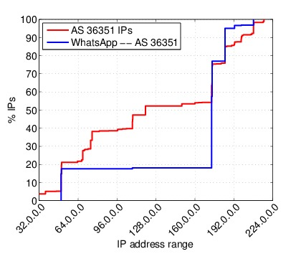

Revealing Hosting Infrastructure Through large-scale passive measurements
386 IP adresses used by Whatsapp (chat and media)
All in AS36351 (Softlayer)
Service/AS | #IPs | # /24 | # /16 | # /8
WhatsApp | 386 | 51 | 30 | 24
SoftLayer (AS36351) | 1364480 | 5330 | 106 | 42

Slide 9
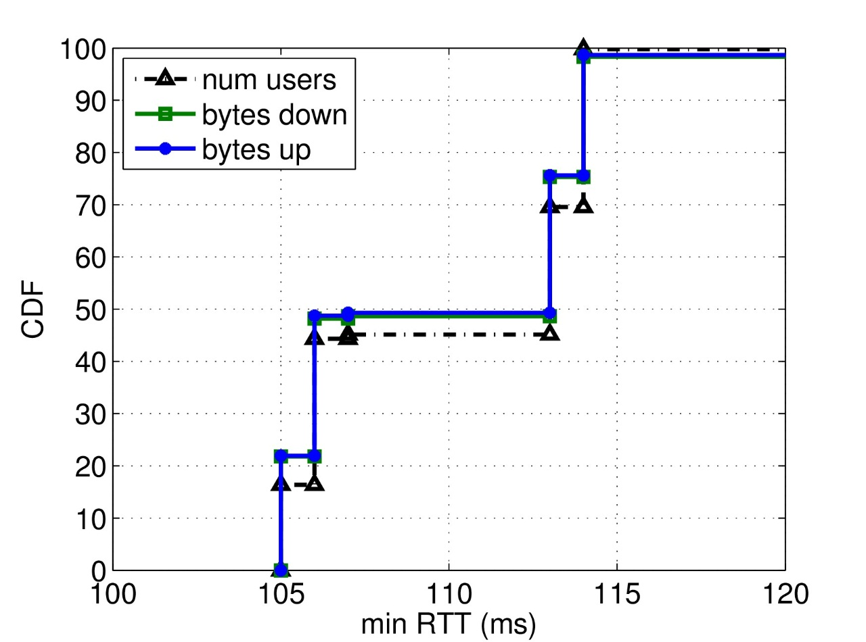

Revealing Hosting Infrastructure Through large-scale passive measurements
Localization of servers through RTT measurements
~400 IP addresses in Softlayer AS
Two big steps in RTT distribution at:
106ms
114ms
Localized by MaxMind in:
Houston
Dallas

Slide 10
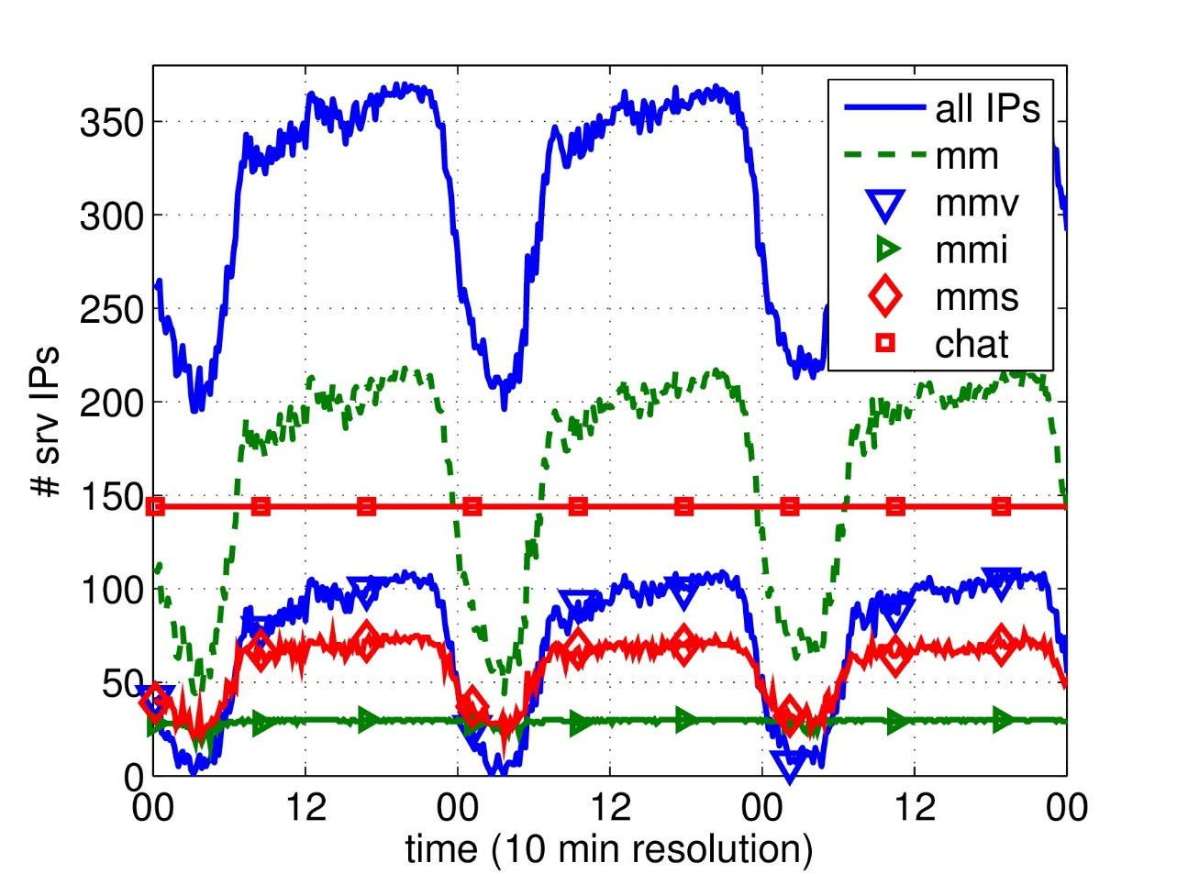
Revealing Hosting Infrastructure Through large-scale passive measurements
Active IPs
Chat servers
150 IPs “always on”
Images exch. servers
25 IPs “always on”
Video exchange servers
Up to 100 IPs at peak hours
Audio exchange servers
Up to 75 IPs at peak hours
At least 200 IP addresses active at any time

Slide 11
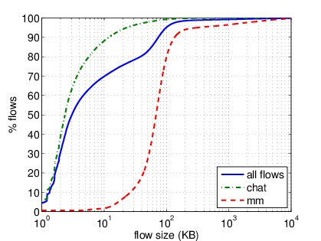
Whatsapp traffic characteristics flow size and throughput
flow size
flow throughput
Smaller chat/control flows and heavier mm flows
90% of chat flows < 10KB
50% of mm flows > 70KB
Only bigger flows (>1MB) considered
Up to 1.5Mbps in downlink
Up to 800Kbps in uplink

Slide 12
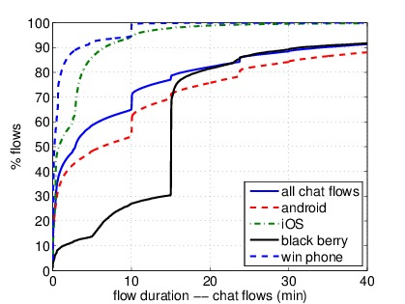
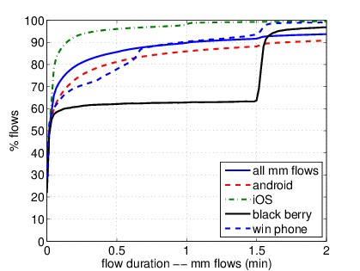
Whatsapp traffic characteristics flow duration with OS breakdown
flow duration (chat flows) [m]
flow duration (mm flows) [m]
Timeouts:
Android: 10/15/25 min
iOS: 3 min
Blackberry: 15 min
Windows Phone: 10 min
Timeouts:
Blackberry: 90 sec
Flow characteristics depend on terminal operating system

Slide 13
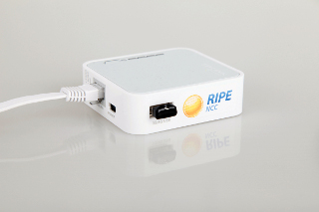
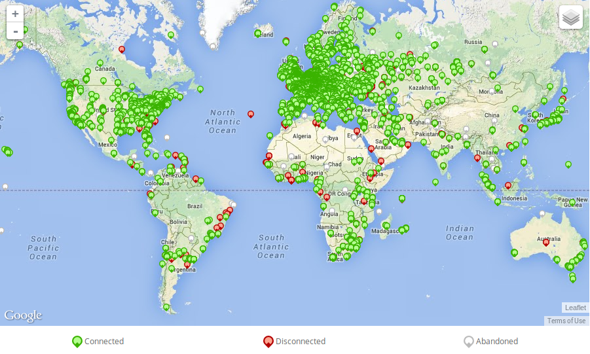
RIPE Atlas infrastructure for geo-distributed active measurements
RIPE NCC: Regional Internet Registry for Europe (equivalent of ARIN for North America)
RIPE Atlas: a large measurement network composed of geographically distributed active probe used to measure connectability and reachabiltiy
http://atlas.ripe.net
RIPE Atlas probe v3
TP-Link MR3020 router with custom firmware

Slide 14
Hosting infrastructure „stability“ Geographical distributed active measurements
http://atlas.ripe.net
My UDM (User Defined Measurement): 600 probes world-wide resolve Whatsapp hostnames ({mmX|dX}.whatsapp.net)
Result: same set of IP addresses
RIPE Atlas probe v3
TP-Link MR3020 router with custom firmware
Previous conclusions for WhatsApp hosting infrastructure are still valid from other VPs

Slide 15
Outline
Characterization of WhatsApp through hybrid measurements
Traffic captures in lab with standard tools
Large-scale passive traces (mobile national network)
Large-scale active measures (RIPE Atlas)
Quality of Experience remarks
Build a QoE model with user tests
Apply model on passive traces
WhatsApp global outage overview
Characterization
Social media impact

Slide 16
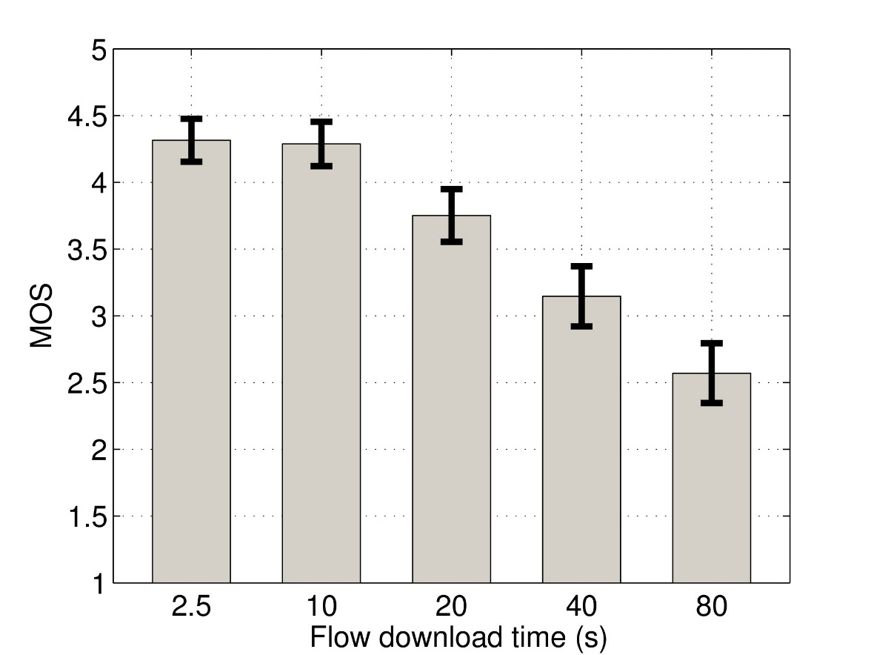
Quality of Experience (QoE) Measuring Mean Opinion Score (MOS) through user tests
Measurement campaign:
50 participants
45/50 male/female
60/40 students/employees
23 average age
Experiment:
Media file transfer (5MB)
Emulation of different network conditions (change transfer time)
Mean Opinion Score (MOS):
From 1 (very bad) to 5 (excellent)
Users tolerate transfers of up to 20 seconds with good experience
Threshold of 40 seconds discriminates good and bad experience
The score is undependent of the flow size

Slide 17
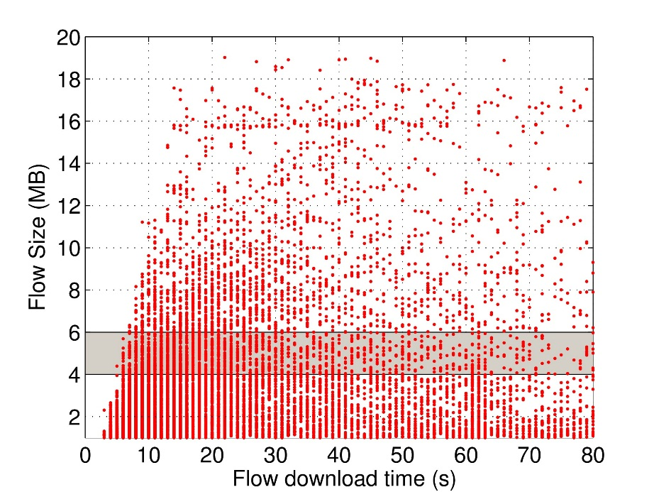
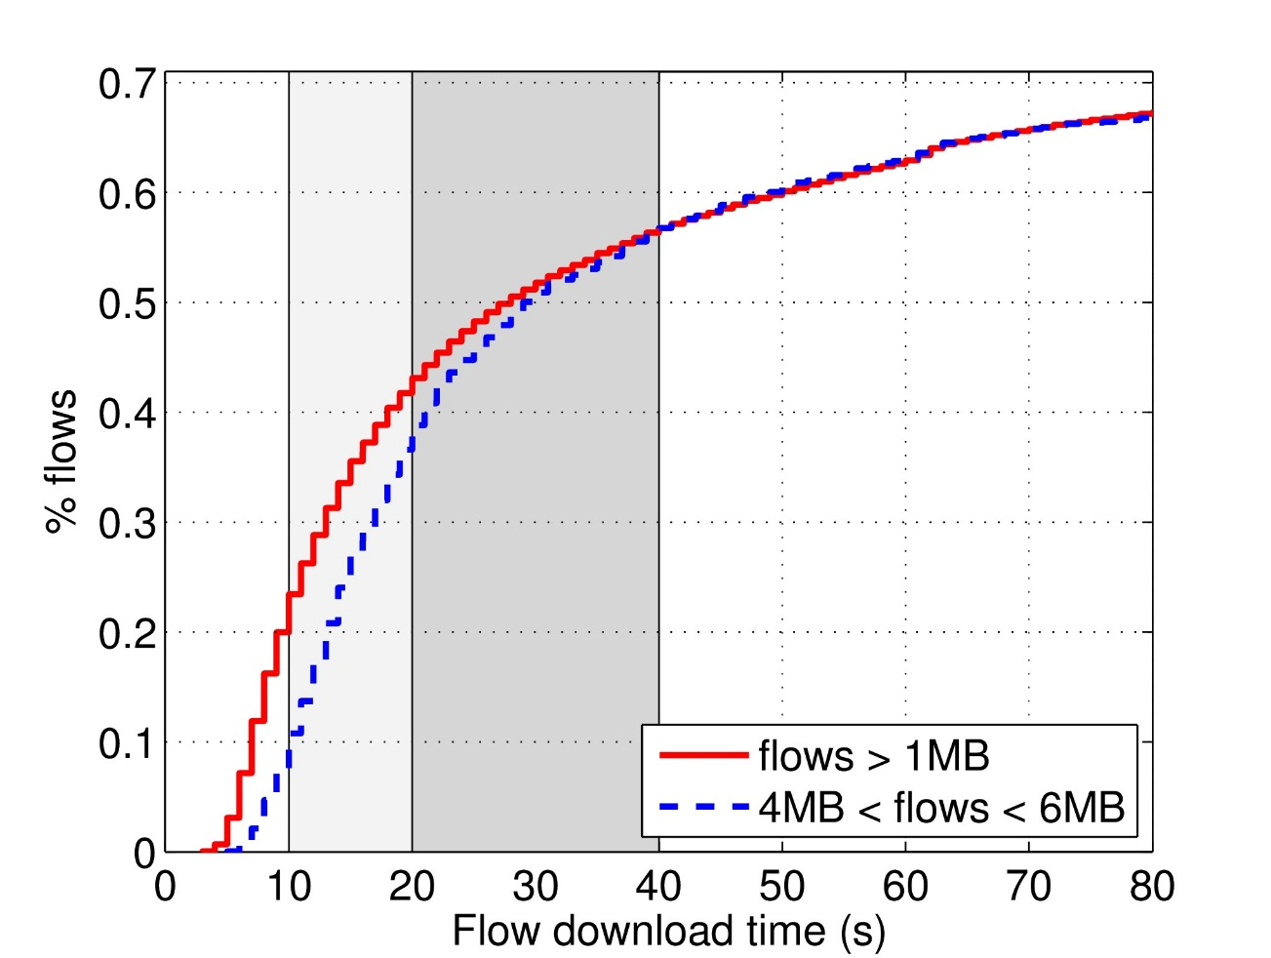
Quality of Experience (QoE) in the large scale measurements
User tests: 5MB transfers, <20s good, >40s bad (previous slide)
Assumption: flow size is not taken into account
Apply same model on large scale network traces
40% flows last less than 20s (good)
60% flows last less than 40s (acceptable)
35% flows are badly/very badly perceived

Slide 18
Outline
Characterization of WhatsApp through hybrid measurements
Traffic captures in lab with standard tools
Large-scale passive traces (mobile national network)
Large-scale active measures (RIPE Atlas)
Quality of Experience remarks
Build a QoE model with user tests
Apply model on passive traces
WhatsApp global outage overview
Characterization
Social media impact

Slide 19
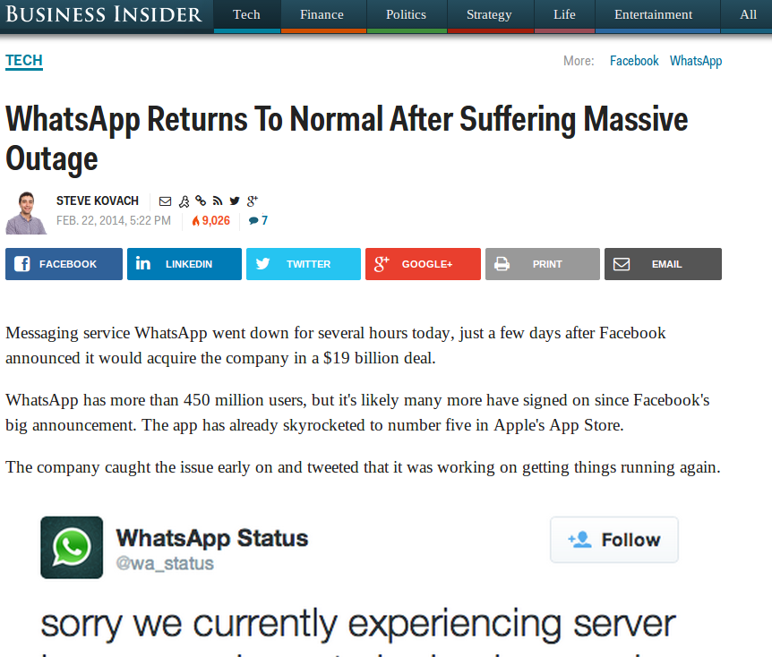
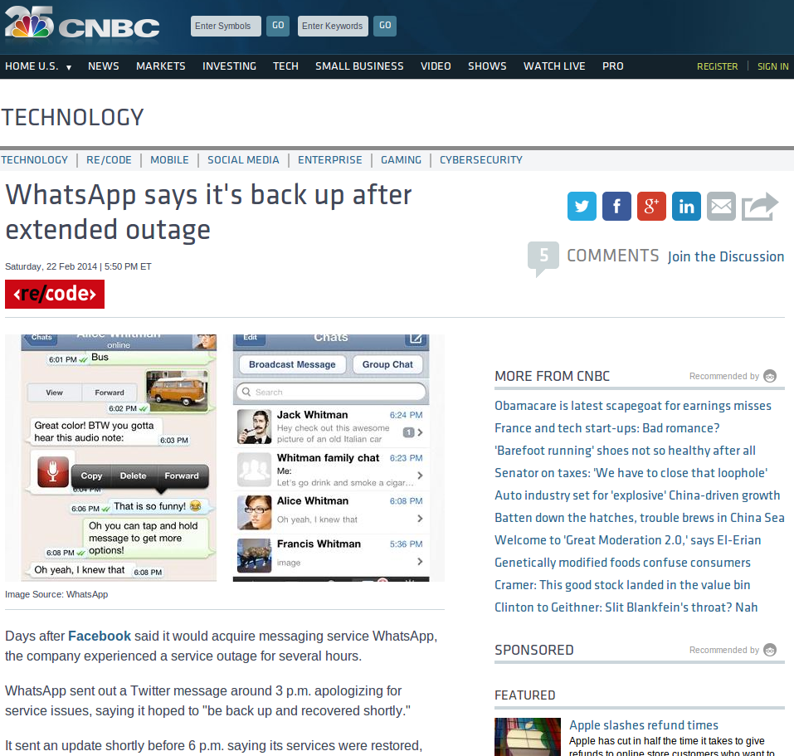
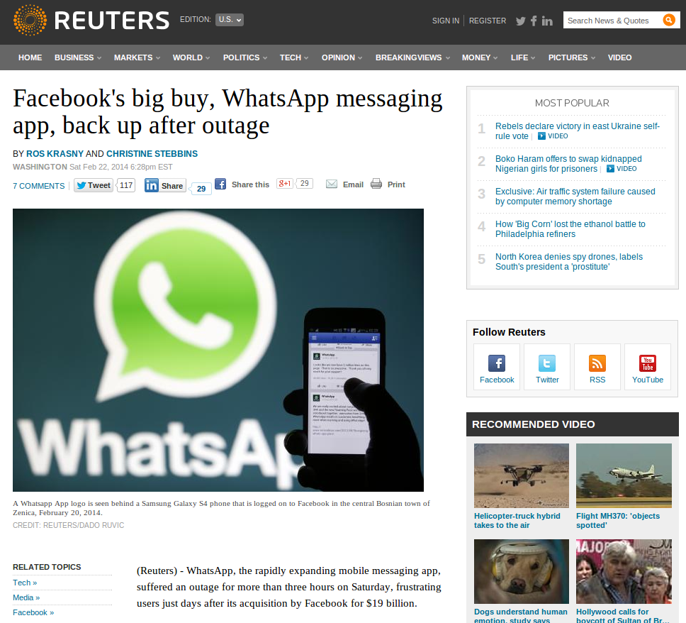
The big 5-hours outage (Feb. 22nd, 2014) press reaction

Slide 20
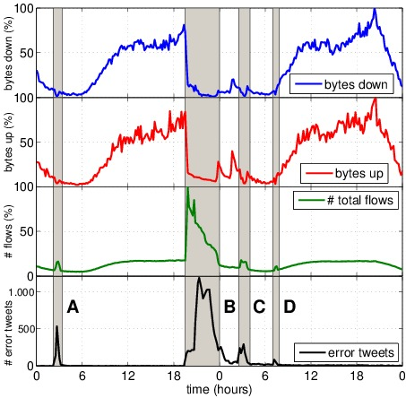

The big outage (Feb. 22nd, 2014) as seen from passive measurements and social feeds
drop in volume down
(with small residual traffic)
drop in volume up
(with small residual traffic)
ramp-up on flow counts
(SYN/RST exchange)
#whatsappdown
Residual traffic during outage
Number of flow increase
Clear social media reactions

Slide 21

Conclusions
Characterization of WhatsApp
Hybrid methodology for service characterization
Revealed *.whatsapp.net server naming scheme
Centralized infrastructure by Softlayer in Texas
75% of volume for media transfers (36% is video)
Quality of Experience remarks
Downlink throughput up to 1.5Mbps, but...
40% of flows could suffer of bad user experience
WhatsApp global outage overview
Servers still reachable, fail at app layer
Strong social media impact ( correlation)

Slide 22

http://www.ftw.at
http://www.ict-mplane.eu
thank you for you attention!
Pierdomenico Fiadino
Telecommunications Research Center of Vienna (FTW)
<fiadino@ftw.at>
backup slides =>

Slide 23
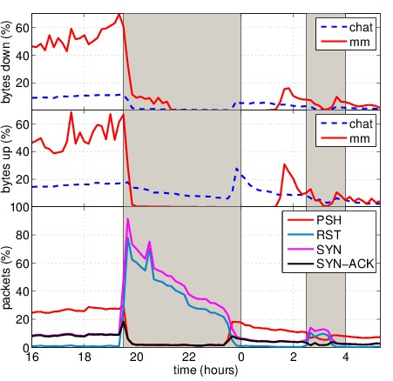
The big outage (Feb. 22nd, 2014) as seen from passive measurements and social feeds
residual volume down (mm)
residual volume up (chat)
TCP flags counters

